Slide 1

CAREER SPARK
By
Team - CODE SKETCHERS
Organization name : National Digital Education Architecture (NDEAR), Department of School Education & Literacy (DoSEL)
Problem Statement title: An AI&ML Based Career Guidance Tool
PS Number : AK1085
Category : Software

Slide 2
Problem Statement
Students have insufficient access to resources and no proper guidance. Mixed opinions from people leads to more confusions as to which career path to take up.
Solution
AI/ML based website & Android app

Slide 3
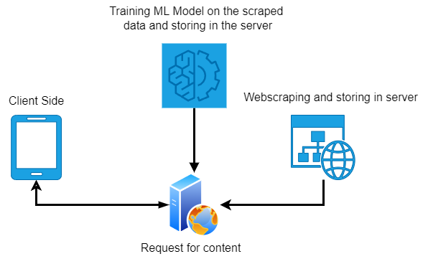
Tech stack
AI & ML
Python
Backend
FastAPI
SQLite
Web
HTML
CSS
Javascript
Bootstrap
JQuery
Android

Slide 4
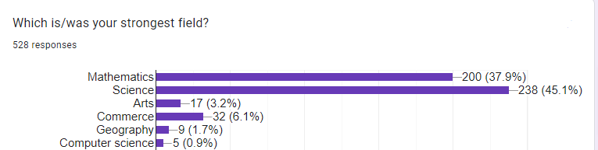
Data collection and Data visualization
https://forms.gle/xByEwDiSUVFMFwfw5

Slide 5

Algorithm Used

Slide 6
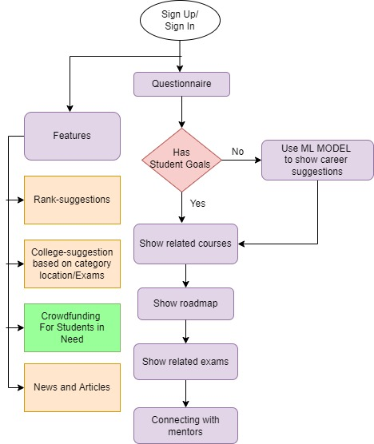
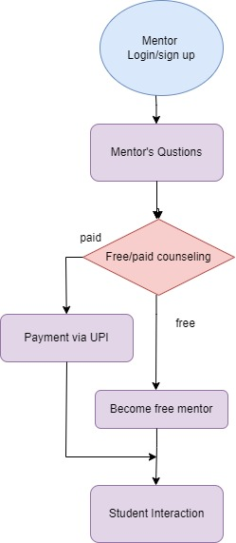
Workflow Diagram

Slide 7
Conclusion & Future Enhancement
Conclusion
Connecting with mentors
Crowd funding - Financial aid
Rank , college and Exam suggestion
NEWS Portal
Responsive Website and Android App
Future Enhancement
Scaling up with the dataset and career options
Implementing a discussion forum and a business model
CAREER SPARK

Slide 8
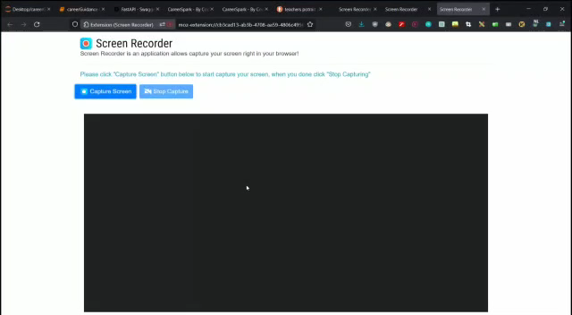
Any Queries?
Video on the flow of career spark
8/26/2022
CAREER SPARK

Slide 9
Thank you
8/26/2022
CAREER SPARK

